Slide 1



Optimizing Operations: Reporting, Supervision & Quality Assurance
Sheraz Abbasi

Slide 2





Services Offerings
Reporting
Supervision
Quality Assurance
Stay updated with bi-weekly comprehensive reports. Clear visual formats and detailed Excel sheets enhance transparency, empowering confident decisions
Ensure accuracy and efficiency with our dedicated medical billing supervision services. Trust us to oversee the process meticulously, optimizing your billing workflow.
Elevate accuracy and excellence through our specialized quality assurance services for medical billing. Count on us to enhance your billing reliability and performance..

Slide 3


MedQuill’s Reporting Format
Daily Charges Entry
Daily Receipts from Insurance & Patients
Aging Bucket Details
Insurance wise Due Payments
Accepted/ Rejected / Denied Claims & Balance
EFT & Check wise Payment Details
Snapshot of Reporting on MS Excel

Slide 4
Reporting
Charges Entry
8/1 – 8/24

Slide 5
Reporting
Charges Entry
8/1 – 8/24

Slide 6
Reporting
Receipt of Insurance Payments
8/1 – 8/17

Slide 7
Reporting
Receipt of Patients Payments
8/1 – 8/17

Slide 8
Reporting
Due Balance of Insurance Payments
8/1 – 8/17

Slide 9
Reporting
Due Balance of Patients Payments
8/1 – 8/17

Slide 10
Reporting
Aging Bucket Details
8/1 – 8/24

Slide 11
Reporting
Insurance Specific Dues (Year-to-date)
1/1 – 8/17

Slide 12
Reporting
120+ Bucket List
Insurance Specific Dues

Slide 13
Reporting
Monthly Due Payment
Insurance Specific

Slide 14
Reporting
Patient Payment Details
Check-wise

Slide 15
Reporting
Daily Basis Claims Entry
(Excel Format)
Month | Paid |  | Inprocess |  | Total Claims | Total Amount
 | Claims | Amount | Claims | Amount
08/01/2023 | 40 | $ 5,310.06 | 8 | $ 1,185.00 | 48 | $ 6,495.06
08/02/2023 | 40 | $ 4,874.05 | 7 | $ 950.00 | 47 | $ 5,824.05
08/03/2023 | 28 | $ 2,993.23 | 12 | $ 2,116.10 | 40 | $ 5,109.33
08/04/2023 | 34 | $ 3,973.00 | 12 | $ 1,957.91 | 46 | $ 5,930.91
08/07/2023 | 37 | $ 3,782.36 | 7 | $ 700.00 | 44 | $ 4,482.36
08/08/2023 | 32 | $ 4,962.04 | 12 | $ 1,275.00 | 44 | $ 6,237.04
08/09/2023 | 46 | $ 5,404.88 | 14 | $ 2,021.91 | 60 | $ 7,426.79
08/10/2023 | 37 | $ 4,412.06 | 7 | $ 675.00 | 44 | $ 5,087.06
08/11/2023 | 13 | $ 1,270.82 | 14 | $ 1,818.00 | 27 | $ 3,088.82
08/14/2023 | 20 | $ 2,260.00 | 20 | $ 2,624.00 | 40 | $ 4,884.00
08/15/2023 | 20 | $ 1,924.17 | 22 | $ 3,515.00 | 42 | $ 5,439.17
08/16/2023 | 7 | $ 285.00 | 33 | $ 4,470.06 | 40 | $ 4,755.06
08/17/2023 | 7 | $ 175.00 | 33 | $ 4,269.21 | 40 | $ 4,444.21
08/18/2023 | 3 | $ 220.00 | 40 | $ 5,369.22 | 43 | $ 5,589.22
08/21/2023 | 6 | $ 260.00 | 51 | $ 6,867.73 | 57 | $ 7,127.73
08/22/2023 | 11 | $ 465.00 | 44 | $ 6,782.22 | 55 | $ 7,247.22
08/23/2023 | 4 | $ 100.00 | 51 | $ 7,294.48 | 55 | $ 7,394.48
08/24/2023 | 6 | $ 540.00 | 25 | $ 2,861.73 | 31 | $ 3,401.73
Grand Total | 391 | $ 43,211.67 | 412 | $ 56,752.57 | 803 | $ 99,964.24

Slide 16
Reporting
Claims Report
Year-to-date
Month | Current Claims |  | Paid Claims |  | Aged Claims |  | Patient Balance |  | Total Claims | Total Amount
 | Claims | Amount | Claims | Amount | Claims | Amount | Claims | Amount
January | 0 | $ - | 84 | $ 23,272.00 | 1 | $ 255.00 | 9 | $ 2,474.00 | 94 | $ 26,001.00
February | 0 | $ - | 56 | $ 15,198.00 | 0 | $ - | 4 | $ 1,382.00 | 60 | $ 16,580.00
March | 0 | $ - | 94 | $ 25,155.00 | 1 | $ 343.00 | 12 | $ 3,583.00 | 107 | $ 29,081.00
April | 0 | $ - | 82 | $ 22,612.00 | 3 | $ 768.00 | 15 | $ 4,263.00 | 100 | $ 27,643.00
May | 0 | $ - | 64 | $ 17,714.00 | 2 | $ 603.00 | 19 | $ 5,502.00 | 85 | $ 23,819.00
June | 0 | $ - | 58 | $ 16,133.00 | 2 | $ 598.00 | 32 | $ 9,077.00 | 92 | $ 25,808.00
July | 0 | $ - | 28 | $ 7,729.00 | 12 | $ 3,322.00 | 52 | $ 14,545.00 | 92 | $ 25,596.00
August | 26 | $ 7,301.00 | 6 | $ 1,696.00 | 0 | $ - | 20 | $ 5,520.00 | 52 | $ 14,517.00
Grand Total | 26 | $ 7,301.00 | 472 | $ 129,509.00 | 21 | $ 5,889.00 | 163 | $ 46,346.00 | 682 | $ 189,045.00

Slide 17
MedQuill’s Supervision Format
Account Receivables Report & Trends
Monthly Claims & Balance Status
Checks & EFT Details
Aging Snapshot

Slide 18
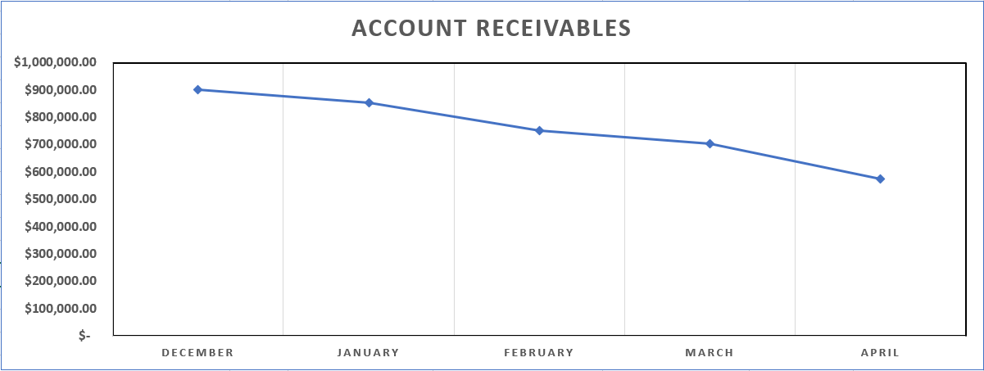
Supervision
Account Receivables
Month | Amount
December | $903,389.49
January | $854,619.73
February | $753,509.55
March | $704,475.73
April | $547,596.82
Account | Receivables | Worked
Status | Claims | Amount
Paid | 420 | $ 303,389.49
Refiled | 301 | $ 254,619.73
Inprocess | 202 | $ 153,509.55
Appealed | 123 | $ 104,475.73
Billed to patient | 92 | $ 74,596.82
Adjusted | 36 | $ 10,422.07
Provider Issue | 15 | $ 9,062.95
Refund | 17 | $ 7,261.19
Resubmitted | 5 | $ 2,628.00
Billed To Secondary | 2 | $ 145.91
Grand Total | 1213 | $ 920,111.44

Slide 19
Supervision

Slide 20
Supervision
Monthly Claims Status
8/1 – 8/24

Slide 21
Supervision
Monthly Balance Status
8/1 – 8/24

Slide 22
Supervision
Patient Payment Details
Check-wise

Slide 23
Supervision
Claims & Aging Report
Year-to-date
Month | Claims | Total Charges | Total Payments | Total Balance
Apr-2023 | 97 | $ 12,145.16 | $ 2,348.18 | $ 9,796.98
Aug-2023 | 553 | $ 70,543.53 | $ 11,078.21 | $ 59,465.32
Feb-2023 | 60 | $ 8,068.42 | $ 2,222.99 | $ 5,845.43
Jan-2023 | 90 | $ 12,335.70 | $ 2,470.53 | $ 9,865.17
Jul-2023 | 91 | $ 10,707.23 | $ 1,891.28 | $ 8,815.95
Jun-2023 | 89 | $ 11,150.67 | $ 2,135.51 | $ 9,015.16
Mar-2023 | 103 | $ 12,401.73 | $ 1,406.53 | $ 10,995.20
May-2023 | 85 | $ 10,859.83 | $ 1,916.88 | $ 8,942.95
Grand Total | 1168 | $ 148,212.27 | $ 25,470.11 | $ 122,742.16
Details | 0-30 |  | 31-60 |  | 61-90 |  | 91-120 |  | 120+ |  | Overall
 | Claims | Total Balance | Claims | Total Balance | Claims | Total Balance | Claims | Total Balance | Claims | Total Balance | Total Claims | Total Balance
Current AR (08/24/2023) | 433 | $ 65,452.75 | 42 | $ 5,409.00 | 62 | $ 8,776.11 | 65 | $ 8,390.11 | 207 | $ 29,881.00 | 809 | $ 119,218.04
Previous AR (08/22/2023) | 417 | $ 55,452.75 | 44 | $ 5,702.76 | 72 | $ 9,212.63 | 61 | $ 8,091.20 | 231 | $ 31,190.07 | 825 | $ 108,340.34
Variance | 16 | $ 10,000.00 | -2 | $ (293.76) | -10 | $ (436.52) | 4 | $ 298.91 | -24 | $ (1,309.07) | -16 | $ 10,877.70

Slide 24
MedQuill’s Quality Assurance Format
AAA
BBB
CCC
DDD

Slide 25



Financial Proposal
Comprehensive Twice a week Reporting
Comprehensive Supervision
Quality Assurance
$500
$500
$500
Financial Proposal with Discount / month | $$ | $$
Reporting | $500
Supervision | $500
Quality Assurance | $500
Sub-Total |  | $1,500
Discount |  | ($500)
Grand Total |  | $1,000

Slide 26




Thank You
5250 Bronway St.
Houston, TX 77506
inquiry@med-quill.com
+1 (832) 213-6337
MEDICAL BILLING AND RCM ON- BOARDING PROCESS
WWW.MED-QUILL.COM

